Slide 1
SAP HANA Information Composer

Slide 2
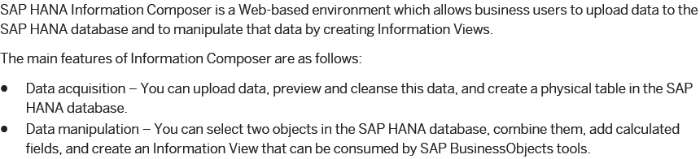
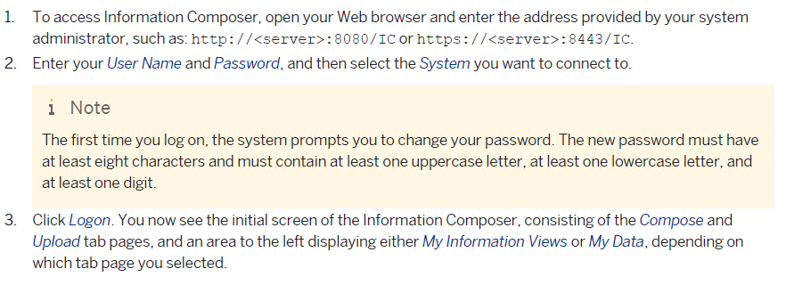

Slide 3
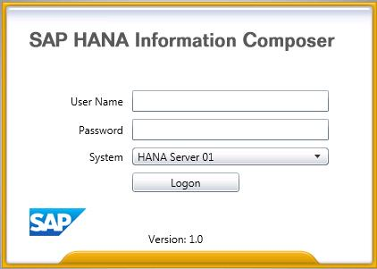
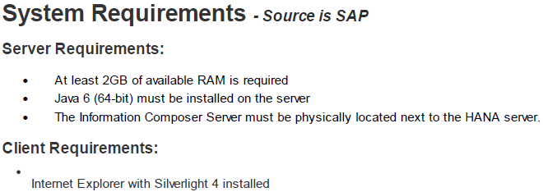
The Initial Screen

Slide 4
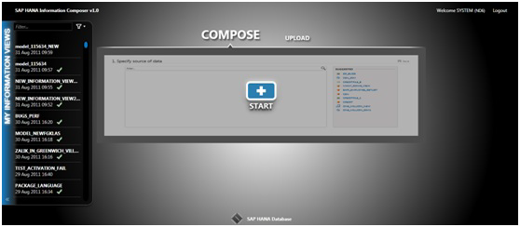

Slide 5
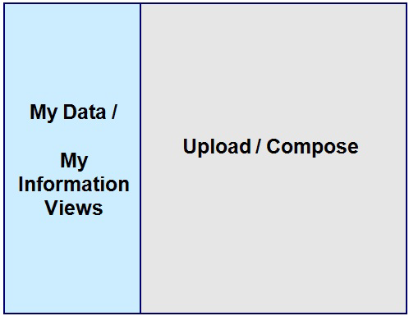

Slide 6
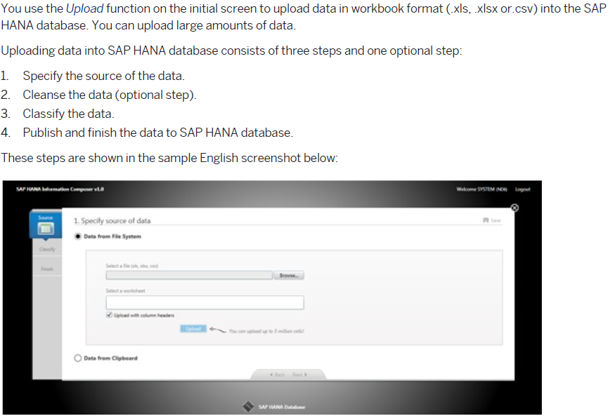

Slide 7
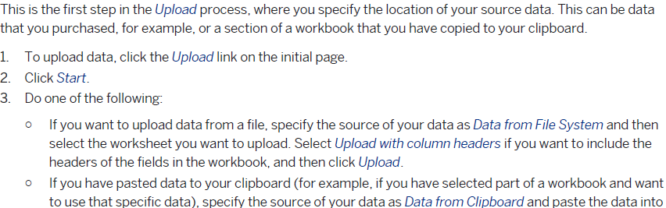
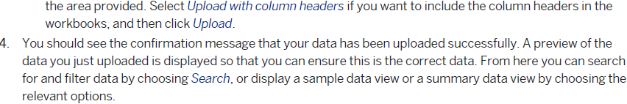
Specifying the Source

Slide 8
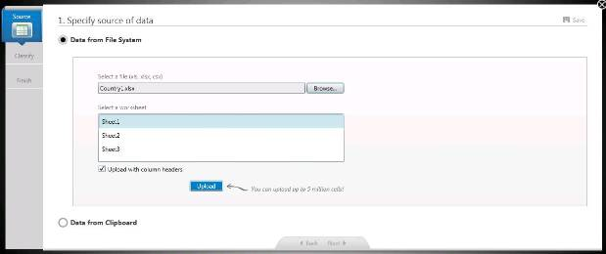
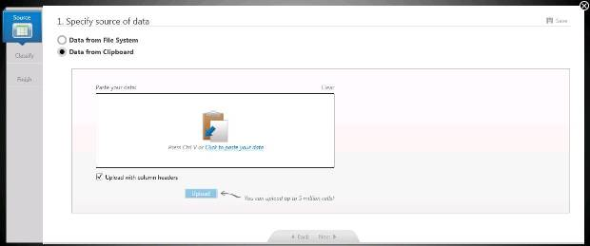

Slide 9
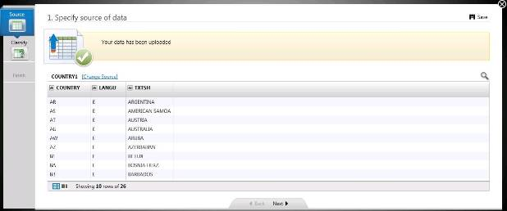
Once the data is uploaded (in temporary storage), it will display a preview of the data set uploaded. Spyglass on the right hand side will help to search a particular entry.
By default the data is stored in columnar format under schema IC_TABLES where table name starts with “ic/”

Slide 10

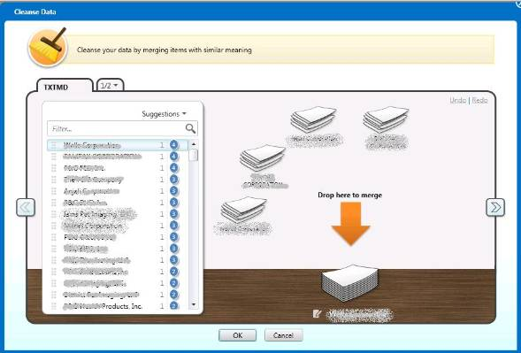
Cleansing Data (Optional)

Slide 11
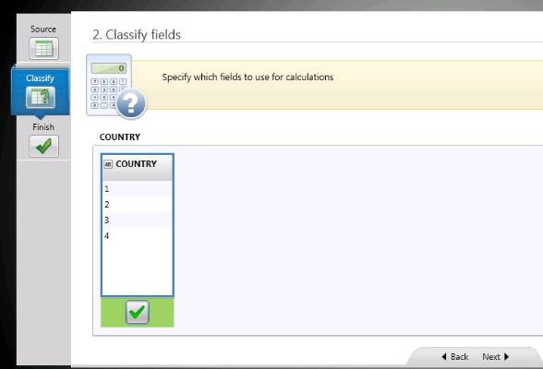
Classifying Data
Next step is to classify the data, whether it is a measure or an attribute (measures can be used for mathematical calculations). The tool itself shows all the fields that can be considered as a measure. One needs to select them manually by selecting the respective checkbox.
Note: A separate index field (which is also the primary key) is created by default for every physical table created with the help of IC

Slide 12
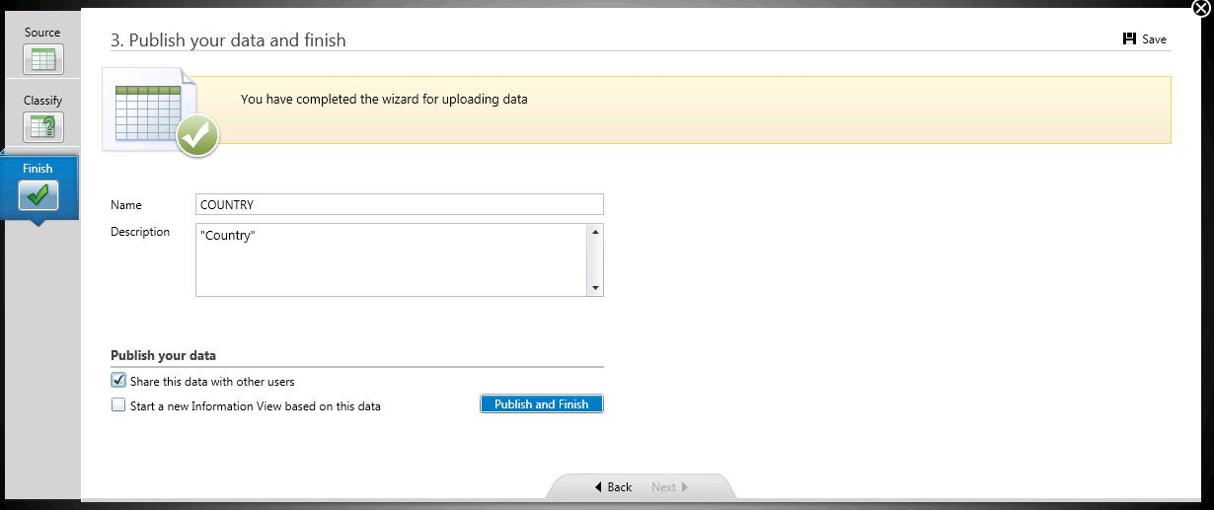
Publishing and Finishing
Publication or the final step of creation and loading of physical table into HANA database. Provide a technical name and description (make sure no other table with the same name is there inside the IC_TABLES schema).
Once the “Share data with other users” is selected users having IC_PUBLIC role can view the uploaded data set/ physical table.
“Start a new information View based on this data” will automatically jump to the next modeling screen where present data set will act as the first data source.

Slide 13
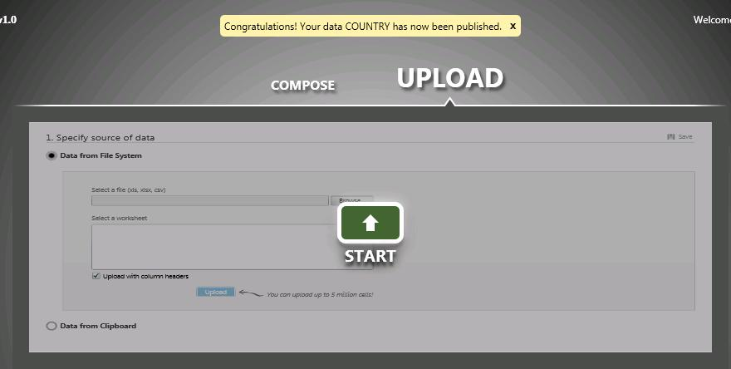
Two sets of roles can be assigned to users who will use Information Composer. IC_MODELER is for creating physical tables, uploading data and creating information views. The other one is the IC_PUBLIC, this role allows users to view information views created by other users. This role doesn’t allow user to upload of create any information views using IC.

Slide 14
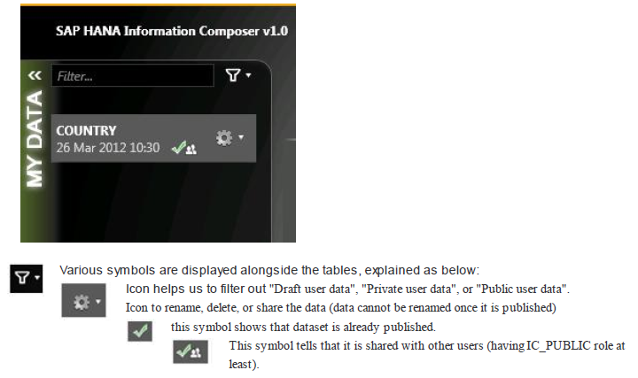

Slide 15
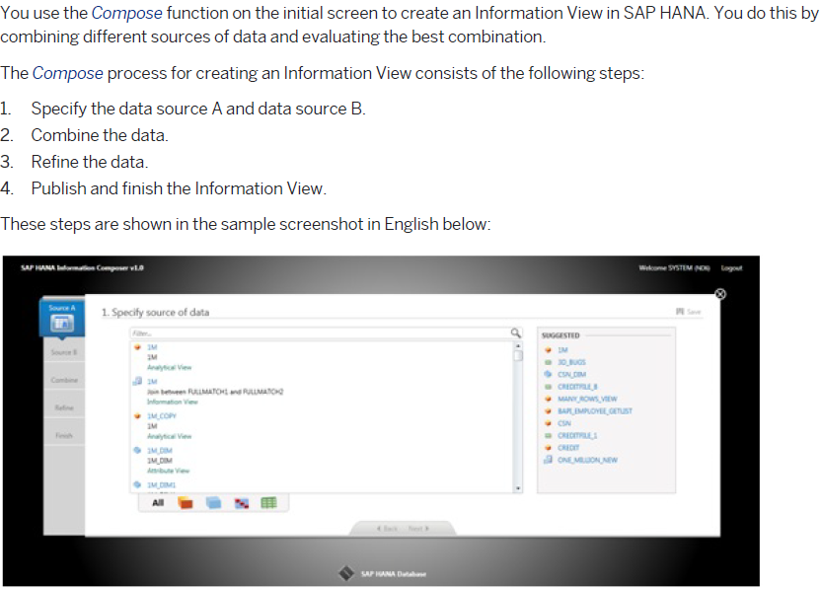
Creating Information Models

Slide 16
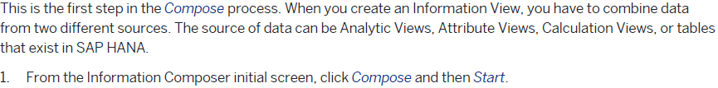
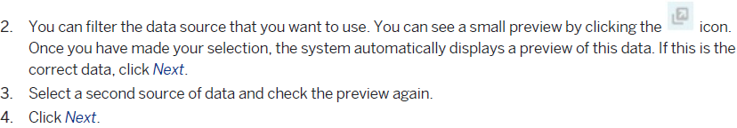
Specify Data source

Slide 17
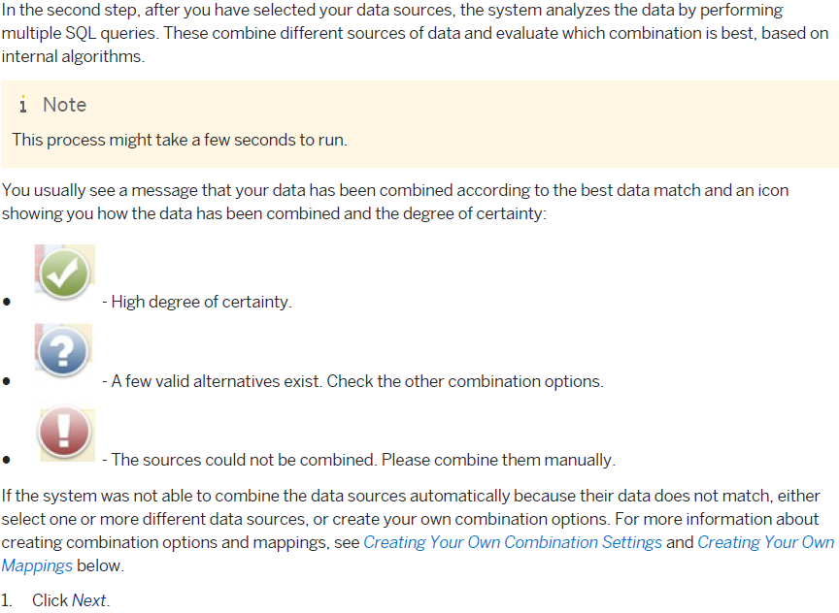
Combining Data

Slide 18
Refining Data
In the third step in the Compose process, you can refine the data and make any changes before publishing the model view to SAP HANA. For example, click Manage Fields to hide any fields that you do not want to display.
You can also create your own calculated fields.
When you have finished, click Next.

Slide 19
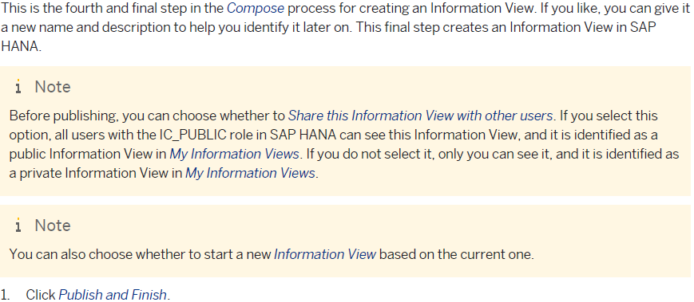
Publishing and Finishing

Slide 20
THANK YOU

